Slide 1

Having Courageous Conversations in Placements: Feelings, Failings and Frustrations
The 3 F’s
Dr Jo Finch
Reader in Social Work & Deputy Director Centre for social Work Research, University of east london
J.Finch@uel.ac.uk @jojofinchers @CSWR_UEL
Kingston University 5thJune 2019

Slide 2
Outline of Presentation
Brief Introductions
My research to date
Failings, Feelings and lots of frustration
Courageous Conversations
The Process in Brief
Concluding Comments

Slide 3
Social work educator for 17 years
Brief Introductions
Long standing research interest in practice learning and assessment
Say hello to someone near you who you do not know and tell them what you like doing outside of work
Former children and families social worker, practice educator and play therapist

Slide 4
Social work educator for 17 years
Brief Introductions
Long standing research interest in practice learning and assessment
….I like baking cakes……
Former children and families social worker, practice educator and play therapist

Slide 5
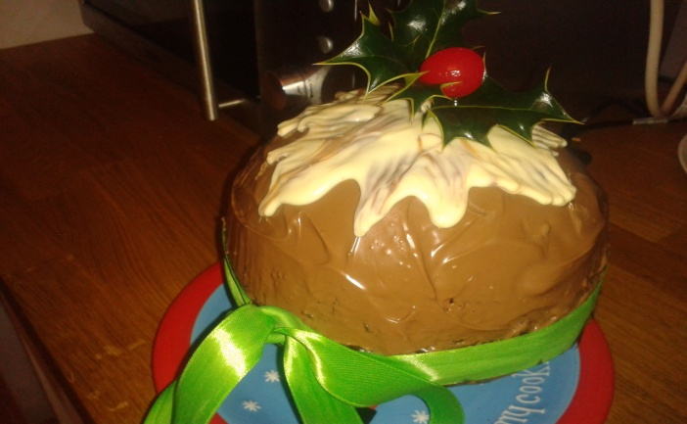
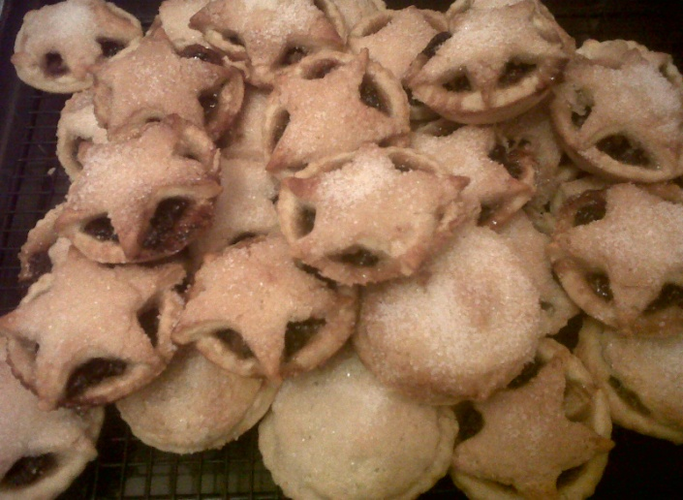
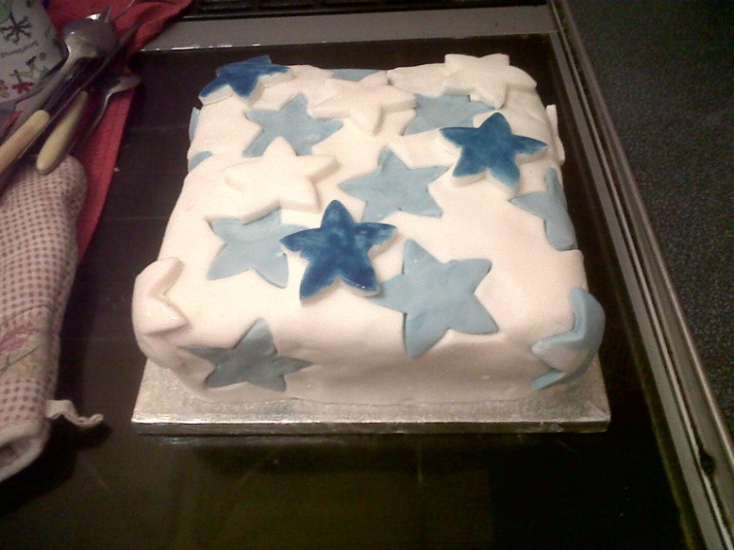
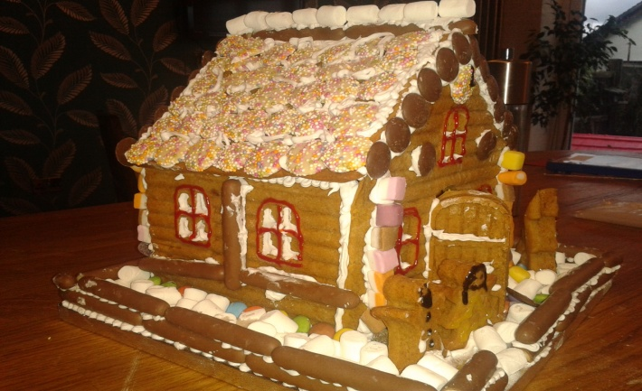
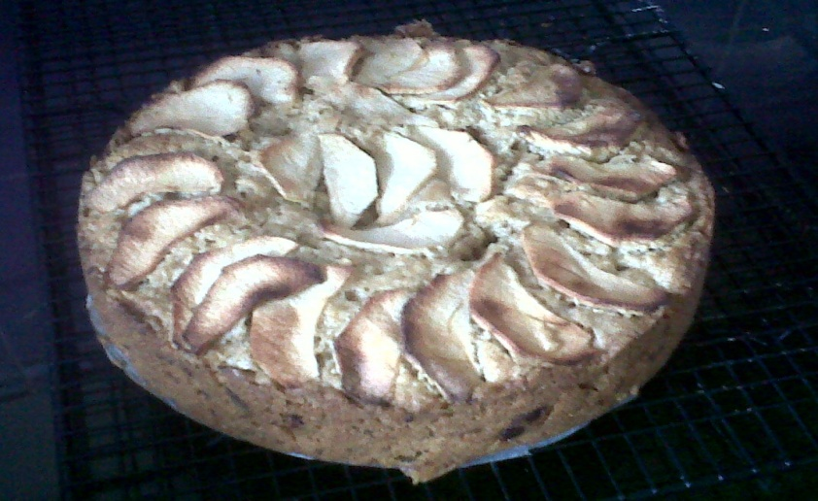
Social work educator for 17 years
Brief Introductions
Long standing research interest in practice learning and assessment
….I like baking cakes……
Former children and families social worker, practice educator and play therapist

Slide 6
My research to date in practice learning
1) Qualitative study of practice educators experiences of working with failing students and why difficult to fail (DSW thesis) Finch, 2010; Finch and Taylor, 2013).
2) Qualitative study of tutors experiences of working with struggling or failing students in placement (Finch, 2014)
3) Mixed method study of practice assessment panels (including an ethnographic exploration of PAPs, looking at decision making around failing students (Finch, 2013, 2015)

Slide 7
My research to date in practice learning
1) Qualitative study of practice educators experiences of working with failing students and why difficult to fail (DSW thesis) Finch, 2010; Finch and Taylor, 2013).
2) Qualitative study of tutors experiences of working with struggling or failing students in placement (Finch, 2014)
Comparative study – UK and Italian practice educators experiences (Finch and Poletti, 2013)
Exploration of how far the concept of projective identification may help us to understand the difficulties in failing social work students in placement. (Finch, Schaub and Dalrymple, 2013; Finch and Schaub, 2015)
3) Mixed method study of practice assessment panels (including an ethnographic exploration of PAPs, looking at decision making around failing students (Finch, 2013, 2015)

Slide 8
My research to date in practice learning
1) Qualitative study of practice educators experiences of working with failing students and why difficult to fail (DSW thesis) Finch, 2010; Finch and Taylor, 2013).
2) Qualitative study of tutors experiences of working with struggling or failing students in placement (Finch, 2014)
Comparative study – UK and Italian practice educators experiences (Finch and Poletti, 2013)
Exploration of how far the concept of projective identification may help us to understand the difficulties in failing social work students in placement. (Finch, Schaub and Dalrymple, 2013; Finch and Schaub, 2015)
3) Mixed method study of practice assessment panels (including an ethnographic exploration of PAPs, looking at decision making around failing students (Finch, 2013, 2015)

Slide 9
So I am interested in exploring…
Feelings and emotions in practice
Having to give “difficult feedback” (feelings and frustrations)
The resonance between practice education - working with struggling students and social work practice, i.e management, supervising staff, working with others and working with service users (feelings, failing and frustrations)

Slide 10
FEELings about failing: Reflective Exercise
FAIL FAILURE FAILING FAIL FAILING FAILURE
On a piece of paper write down;
1) Something you have failed at in the past (for example, O’level maths, driving test, relationship)
2) How did it make you feel at the time? (use any language you like, or drawings to fully convey the feelings)
3) How do you feel now when you think about it?
4) Pass paper to me (will come back to later – don’t put name on it!)

Slide 11
The Frustrations: Why it is difficult to fail? (what the literature says)
PEs/mentors not using competency model of assessment appropriately
Procedures for dealing with placement issues, not being followed properly
PEs/mentors not adequately supported by agency and/or HEI
Role strain or confusion
Fear of litigation
Rule of Optimism
Hope that things “sort themselves out” without intervention
Challenging emotional experience

Slide 12
The Frustrations: Why it is difficult to fail? (what the literature says)
Reflective Questions
Discuss with the person next to you
Do these resonate with you as a practice educator?
Do they resonate with you as a social worker and/or a manager?
Think about a particular incident these reasons for not addressing “issues” may have been applicable
PEs/mentors not using competency model of assessment appropriately
Procedures for dealing with placement issues, not being followed properly
PEs/mentors not adequately supported by agency and/or HEI
Role strain or confusion
Fear of litigation
Rule of Optimism
Hope that things “sort themselves out” without intervention
Challenging emotional experience

Slide 13
Feelings: Limited (but growing International and Multidisciplinary research base about the emotional impact}
Bogo at al (2007) – failing students causes value conflicts for practice educators.
Gizara and Forest (2004) – ““I think that it’s an extremely emotional, gut-wrenching kind of experience…I don’t think it feels good on any level.”
Basnett and Sheffield (2010) – experience of failing student a negative one
Schaub and Dalrymple (2013) practice educators reported feeling stressed, isolated and did not feel supported.
Finch (2010) found the experience caused range of challenging emotions

Slide 14
Feelings: Limited (but growing International and Multidisciplinary research base about the emotional impact}
GUILT
ANGER
SHAME
ANXIETY
Bogo at al (2007) – failing students causes value conflicts for practice educators.
Gizara and Forest (2004) – ““I think that it’s an extremely emotional, gut-wrenching kind of experience…I don’t think it feels good on any level.”
Basnett and Sheffield (2010) – experience of failing student a negative one
Schaub and Dalrymple (2013) practice educators reported feeling stressed, isolated and did not feel supported.
Finch (2010) found the experience caused range of challenging emotions
ISOLATION
STRESS
SADNESS
FRUSTRATION
DREAD
Disappointment
FEAR

Slide 15
Feelings: Limited (but growing International and Multidisciplinary research base about the emotional impact}
“…and then the guilt really set in….the sacrifices she’s made…this is her livelihood, her career and its all my fault…I felt like I am a rotten shit.” (Daisy
GUILT
Bogo at al (2007) – failing students causes value conflicts for practice educators.
Gizara and Forest (2004) – ““I think that it’s an extremely emotional, gut-wrenching kind of experience…I don’t think it feels good on any level.”
Basnett and Sheffield (2010) – experience of failing student a negative one
Schaub and Dalrymple (2013) practice educators reported feeling stressed, isolated and did not feel supported.
Finch (2010) found the experience caused range of challenging emotions
“it was the first fail, I felt terribly guilty, I felt really…I had sleepless nights, felt quite sick, I felt incredibly guilty….” (Claire)

Slide 16
Feelings: Limited (but growing International and Multidisciplinary research base about the emotional impact}
“…and then the guilt really set in….the sacrifices she’s made…this is her livelihood, her career and its all my fault…I felt like I am a rotten shit.” (Daisy
Because at that time I made the decision, the guilt, it was unbearable . . . but at the end of the day, it’s her livelihood, it could have been the end of her career, oh my god, what about her children? (Daisy)
GUILT
Bogo at al (2007) – failing students causes value conflicts for practice educators.
Gizara and Forest (2004) – ““I think that it’s an extremely emotional, gut-wrenching kind of experience…I don’t think it feels good on any level.”
Basnett and Sheffield (2010) – experience of failing student a negative one
Schaub and Dalrymple (2013) practice educators reported feeling stressed, isolated and did not feel supported.
Finch (2010) found the experience caused range of challenging emotions
“it was the first fail, I felt terribly guilty, I felt really…I had sleepless nights, felt quite sick, I felt incredibly guilty….” (Claire)

Slide 17
Feelings: Limited (but growing International and Multidisciplinary research base about the emotional impact}
GUILT
ANGER
SHAME
ANXIETY
Bogo at al (2007) – failing students causes value conflicts for practice educators.
Gizara and Forest (2004) – ““I think that it’s an extremely emotional, gut-wrenching kind of experience…I don’t think it feels good on any level.”
Basnett and Sheffield (2010) – experience of failing student a negative one
Schaub and Dalrymple (2013) practice educators reported feeling stressed, isolated and did not feel supported.
Finch (2010) found the experience caused range of challenging emotions
ISOLATION
STRESS
SADNESS
FRUSTRATION
DREAD
Disappointment
FEAR

Slide 18
Feelings: Limited (but growing International and Multidisciplinary research base about the emotional impact}
“I was really pissed off with him….I felt angry”.
(Claire)
ANGER
Bogo at al (2007) – failing students causes value conflicts for practice educators.
Gizara and Forest (2004) – ““I think that it’s an extremely emotional, gut-wrenching kind of experience…I don’t think it feels good on any level.”
Basnett and Sheffield (2010) – experience of failing student a negative one
Schaub and Dalrymple (2013) practice educators reported feeling stressed, isolated and did not feel supported.
Finch (2010) found the experience caused range of challenging emotions
“I was just very angry at times….I was angry with the student.” (Jenny)
“…and I did actually think the next time you shout at me, I might actually shout back at you because who the fuck do you think you are…” (Daisy)

Slide 19
Feelings: Limited (but growing International and Multidisciplinary research base about the emotional impact}
GUILT
ANGER
SHAME
ANXIETY
Bogo at al (2007) – failing students causes value conflicts for practice educators.
Gizara and Forest (2004) – ““I think that it’s an extremely emotional, gut-wrenching kind of experience…I don’t think it feels good on any level.”
Basnett and Sheffield (2010) – experience of failing student a negative one
Schaub and Dalrymple (2013) practice educators reported feeling stressed, isolated and did not feel supported.
Finch (2010) found the experience caused range of challenging emotions
ISOLATION
STRESS
SADNESS
FRUSTRATION
DREAD
Disappointment
FEAR

Slide 20
Feelings: Limited (but growing International and Multidisciplinary research base about the emotional impact}
“…I still feel that I must have done something wrong with that one because I couldn’t enable him or work with him to see why his way of thinking was inappropriate in social work, never mind in society”. (Lily)
Bogo at al (2007) – failing students causes value conflicts for practice educators.
Gizara and Forest (2004) – ““I think that it’s an extremely emotional, gut-wrenching kind of experience…I don’t think it feels good on any level.”
Basnett and Sheffield (2010) – experience of failing student a negative one
Schaub and Dalrymple (2013) practice educators reported feeling stressed, isolated and did not feel supported.
Finch (2010) found the experience caused range of challenging emotions
“..I think the team just felt helpless in a way. They felt…they couldn’t see what they could do to turn it around.” (Tim)
FRUSTRATION

Slide 21
Feelings: Limited (but growing International and Multidisciplinary research base about the emotional impact}
GUILT
ANGER
SHAME
ANXIETY
Bogo at al (2007) – failing students causes value conflicts for practice educators.
Gizara and Forest (2004) – ““I think that it’s an extremely emotional, gut-wrenching kind of experience…I don’t think it feels good on any level.”
Basnett and Sheffield (2010) – experience of failing student a negative one
Schaub and Dalrymple (2013) practice educators reported feeling stressed, isolated and did not feel supported.
Finch (2010) found the experience caused range of challenging emotions
ISOLATION
STRESS
SADNESS
FRUSTRATION
DREAD
Disappointment
FEAR

Slide 22
Feelings: Limited (but growing International and Multidisciplinary research base about the emotional impact}
ANXIETY
Bogo at al (2007) – failing students causes value conflicts for practice educators.
Gizara and Forest (2004) – ““I think that it’s an extremely emotional, gut-wrenching kind of experience…I don’t think it feels good on any level.”
Basnett and Sheffield (2010) – experience of failing student a negative one
Schaub and Dalrymple (2013) practice educators reported feeling stressed, isolated and did not feel supported.
Finch (2010) found the experience caused range of challenging emotions
“…out of my depth…I felt really out of my depth…I was completely out of my depth at that point” (Lily)

Slide 23
Feelings: Limited (but growing International and Multidisciplinary research base about the emotional impact}
Reflective Questions
Discuss with the person next to you
Do these feelings identified resonate with you as a practice educator in your work with a struggling student?
Do these feeling identified resonate with you as a social worker and/or a manager?
Think about a particular incident when these feelings may have been raised
GUILT
ANGER
SHAME
ANXIETY
Bogo at al (2007) – failing students causes value conflicts for practice educators.
Gizara and Forest (2004) – ““I think that it’s an extremely emotional, gut-wrenching kind of experience…I don’t think it feels good on any level.”
Basnett and Sheffield (2010) – experience of failing student a negative one
Schaub and Dalrymple (2013) practice educators reported feeling stressed, isolated and did not feel supported.
Finch (2010) found the experience caused range of challenging emotions
ISOLATION
STRESS
SADNESS
FRUSTRATION
DREAD
Disappointment
FEAR

Slide 24
Feelings: Limited (but growing International and Multidisciplinary research base about the emotional impact}
FAIL FAILURE FAILING FAIL FAILING FAILURE
GUILT
ANGER
SHAME
ANXIETY
Bogo at al (2007) – failing students causes value conflicts for practice educators.
Gizara and Forest (2004) – ““I think that it’s an extremely emotional, gut-wrenching kind of experience…I don’t think it feels good on any level.”
Basnett and Sheffield (2010) – experience of failing student a negative one
Schaub and Dalrymple (2013) practice educators reported feeling stressed, isolated and did not feel supported.
Finch (2010) found the experience caused range of challenging emotions
ISOLATION
STRESS
SADNESS
FRUSTRATION
DREAD
Disappointment
FEAR

Slide 25
Feelings: Limited (but growing International and Multidisciplinary research base about the emotional impact}
The Possible Impact on Decision Making
GUILT
GUILT
Mobilisation (acting out the student’s projections)
Immobilisation (not being able to reflect, think or make a decision)
Defensive behaviours (ie splitting)
Hastily terminated placements or dramatic endings
Not following the assessment procedures
STRESS
ANGER
SHAME
ANGER
ANXIETY
Bogo at al (2007) – failing students causes value conflicts for practice educators.
Gizara and Forest (2004) – ““I think that it’s an extremely emotional, gut-wrenching kind of experience…I don’t think it feels good on any level.”
Basnett and Sheffield (2010) – experience of failing student a negative one
Schaub and Dalrymple (2013) practice educators reported feeling stressed, isolated and did not feel supported.
Finch (2010) found the experience caused range of challenging emotions
SADNESS
ANXIETY
ISOLATION
FRUSTRATION
STRESS
SADNESS
FRUSTRATION
DREAD
Disappointment
SHAME
FEAR
FEAR
Disappointment
DREAD
ISOLATION

Slide 26
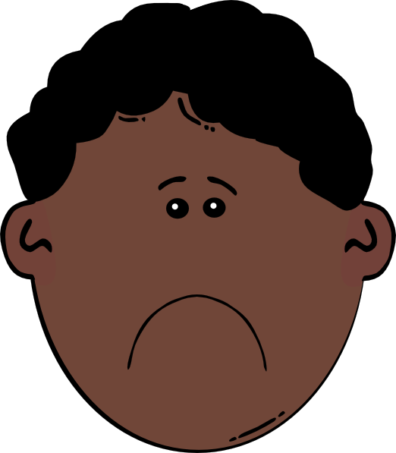

Feelings: Limited (but growing International and Multidisciplinary research base about the emotional impact}
Sadness
Shame
Anger
The Possible Impact on Decision Making
Guilt
Shame
GUILT
Sadness
GUILT
Mobilisation (acting out the student’s projections)
Immobilisation (not being able to reflect, think or make a decision)
Defensive behaviours (ie splitting)
Hastily terminated placements or dramatic endings
Not following the assessment procedures
STRESS
Anger
ANGER
SHAME
ANGER
ANXIETY
Guilt
Helplessness
Bogo at al (2007) – failing students causes value conflicts for practice educators.
Gizara and Forest (2004) – ““I think that it’s an extremely emotional, gut-wrenching kind of experience…I don’t think it feels good on any level.”
Basnett and Sheffield (2010) – experience of failing student a negative one
Schaub and Dalrymple (2013) practice educators reported feeling stressed, isolated and did not feel supported.
Finch (2010) found the experience caused range of challenging emotions
Helplessness
SADNESS
Projective Identification
ANXIETY
ISOLATION
Not my fault
FRUSTRATION
STRESS
SADNESS
FRUSTRATION
I don’t know what to do!!!
DREAD
Disappointment
SHAME
I don’t know what to do!!!
FEAR
FEAR
Disappointment
DREAD
ISOLATION
Persecuted
Persecuted
Practice Educator/
Mentor/supervisor
student

Slide 27
Courageous Conversations
(Beddoe and Davys, 2016)
Or “saying it as it is”! (Jo Finch)
Conversations associated with some sort of emotion
Participants may feel ashamed, apprehensive, uncomfortable, angry & embarrassed
Conversations may be conflicted by introducing different ideas, values or behaviours
Conversations may cause conflict
Need to think about those obstacles in having such conversations

Slide 28
Courageous Conversations
(Beddoe and Davys, 2016)
List what the obstacles are for you in having courageous conversations and then share with the person sitting next to you
Or “saying it as it is”! (Jo Finch)
Conversations associated with some sort of emotion
Participants may feel ashamed, apprehensive, uncomfortable, angry & embarrassed
Conversations may be conflicted by introducing different ideas, values or behaviours
Conversations may cause conflict
Need to think about those obstacles in having such conversations

Slide 29
The Process in Brief
Recognising (and acknowledging) the student is struggling.
Identifying the areas, concerns, developmental needs or issues that need to be addressed (and link to the assessment framework in place)
Making these concerns/issues explicit to the student
Interacting in creative/different ways to support the student to address those areas of concern/developments.
Reviewing to what extent the issues have been addressed and how far the changes made meet the required standards.

Slide 30
The Process in Brief
Identifying the areas, concerns, developmental needs or issues that need to be addressed (and link to the assessment framework in place)

Slide 31
Things to think about (adapted from Maclean 2012)
Are the expected standards set and clearly documented?
Does the practitioner (in this case the student) understand the standards?
In what ways are the standards not being met?
What are the reasons for the standards not being met?
What should the student do to address the issues
What should I do?

Slide 32
The Process in Brief
Need to acknowledge and reflect on the emotional climate and think about what is being communicated
.
Recognising (and acknowledging) the student is struggling.
Identifying the areas, concerns, developmental needs or issues that need to be addressed (and link to the assessment framework in place)
Making these concerns/issues explicit to the student
Interacting in creative/different ways to support the student to address those areas of concern/developments.
Reviewing to what extent the issues have been addressed and how far the changes made meet the required standards.

Slide 33
The Process in Brief
This should be the process for all students
Need to acknowledge and reflect on the emotional climate and think about what is being communicated
.
Recognising (and acknowledging) the student is struggling.
Identifying the areas, concerns, developmental needs or issues that need to be addressed (and link to the assessment framework in place)
Making these concerns/issues explicit to the student
Interacting in creative/different ways to support the student to address those areas of concern/developments.
Reviewing to what extent the issues have been addressed and how far the changes made meet the required standards.

Slide 34
So……… What is your action plan for having courageous conversations?
Who do I need to have a courageous conversation with and why?
What do I need to say?
What might be the emotional response/reaction of the person?
What might I be feeling?
What might be the the barriers to having that conversation?
What would happen if I did not have that conversation?
If time, have that conversation with the person next to you!

Slide 35

Concluding Comments
Working with a struggling or failing student is an emotionally painful experience.
Student will be projecting difficult and challenging feelings onto you.
But I would encourage you to be reflective and consider these feelings as a form of communication.
Also need to consider dynamics created with the university – often can be splitting or university get blamed.
Need to document, address concerns in timely and explicit fashion (don’t ignore).
Seek support (colleagues, university etc)

Slide 36
Useful Reading?
Finch, J. (2017)) Supporting Struggling Students on Placement: A Practice Guide, Policy Press, Bristol
Finch , J and Poletti, A. (2016) Italian and English Practice Educators Experiences of Working with Struggling or Failing Students in Practice Placements in Taylor, I .et al (Eds) Routledge International Handbook of Social Work Education, Routledge, London
Finch, J. (2015) “Running with the Fox and Hunting with the Hounds” Social Work Tutor Experiences of working with Struggling or Failing Students, British Journal of Social Work, 45 (7) pp2124-2141
Finch, J. and Schaub, J. (2015) Finch, Projective Identification as an Unconscious Defence: Social Work, Practice Education and the Fear of Failure. in Armstrong, D. & Rustin, M.(eds) Social Defences against Anxiety: Explorations in the Paradigm, Karnac, London
Finch, J. (2013) Participation, Power, Emotion and Decision Making in Relation to Failing Social Work Students: An Ethnographic and Practice-Near Exploration of Practice Assessment Panels, HEA, York http://www.heacademy.ac.uk/resources/detail/disciplines/hsc/Social-Work-and-Social-Policy/A_critical_exploration_of_PAP_Finch
Finch, J., Schaub, J. & Dalrymple, R. (2013) Projective Identification and the Fear of Failing: Making Sense of Practice Educators’ Emotional Experiences of Failing Social Work Students in Practice Learning Settings, Journal of Social Work Practice,
Finch, J. and Poletti, I. (2013) ‘It’s been hell.’ Italian and British Practice Educators’ Narratives of Working with Struggling or Failing Social Work Students in Practice Learning Settings, European Journal of Social Work, DOI:10.1080/13691457.2013.800026
Finch, J. and Taylor, I. (2013) The Emotional Experience of Assessing a Struggling or Failing Social Work Student in Practice Learning Settings, Special Edition – Field Education, Social Work Education, 32 (2) pp:244-258 DOI: 10.1080/02615479.2012.720250
Finch, J (2010) Finch) Can't fail, won't fail - why practice assessors find it difficult to fail social work students: a qualitative study of practice assessors' experiences of assessing marginal or failing social work students. Doctoral thesis, University of Sussex. Available free: http://sro.sussex.ac.uk/2370
Furness S. & Gilligan, P. (2004) Fit for Purpose: Issues from Practice Placements, Practice teaching and the Assessment of Student's Practice. Social Work Education, 23, 465-479.
LaFrance, J., Fray, E. & Herbert, M. (2004) Gate-Keeping for Professional Social Work Practice. Social Work Education, 23, 325-340.
Salzberger-Wittenberg, I., Williams, G. & Osborne, E. (1983) The Emotional Experience of Learning and Teaching, London, Karnac Books
Sharp , M. & Danbury, H. (1999) The Management of Failing DipSW Students - Activities and Exercises to Prepare Practice Teachers for Work with Failing Students, Aldershot, Ashgate.

