Slide 1


Practice Education Webinar
December 2020
Planning For, and Working with, Individual Difference (with a focus on Dyslexia)
Sarah Cave, Sue Connell & Verity Marklew

Slide 2
Learning Outcomes
To have a clear understanding of the importance of getting to know your student
To explain and use the Mandela Model (Tedam 2010) as a way of understanding difference
To describe the 9 protected characteristics of the Equality Act 2010 and the types of discrimination covered in the Act
To explain and identify when ‘reasonable’ adjustments’ may be necessary, and how this works in practice
To identify common ways that can help a student with dyslexia

Slide 3

I am an individual because…..

Slide 4
Building a relationship with your student
Important to build a genuine, positive working relationship, as the student works closely with you for 70 or 100 days
It is important to learn about your student to be able to support them appropriately, exploring similarities and differences and revisiting this throughout the year
It can be helpful to use models or direct work tools to do this, i.e. Social GGRRAACCEESS, Mandela Models, check ins that explore and record changes over time (ie postcards/objects/York reflection model) https://padlet.com/sarahevason/Bookmarks
A student’s positive experience can lead to them staying on to apply for work in your agency - improved staff retention

Slide 5
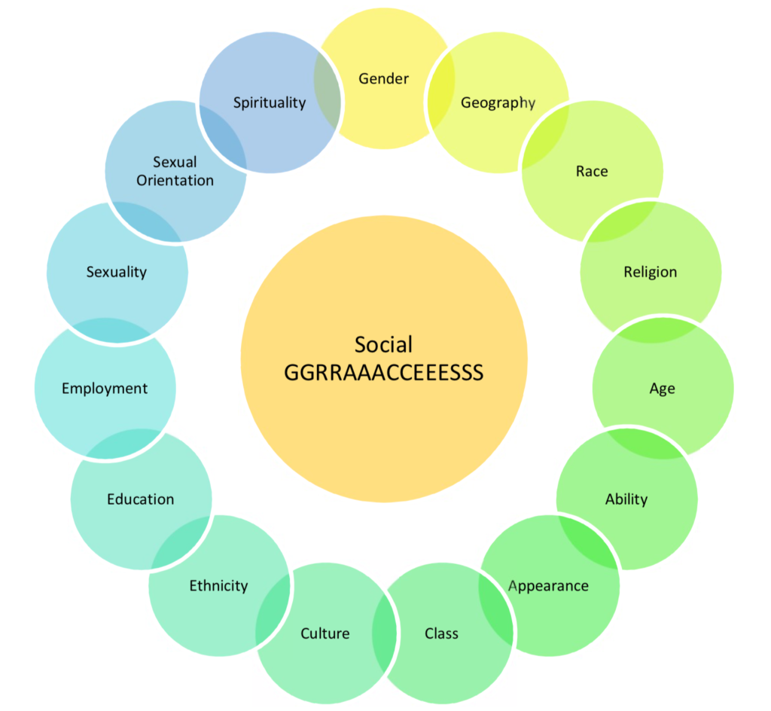
Social GGRRAAACCEEESSS (Burnham 2008)

Slide 6
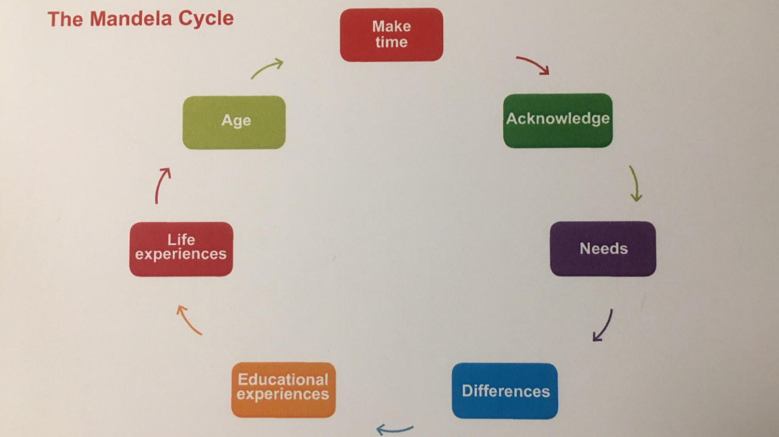
The Mandela Cycle
‘An Old Present in New Wrapping?’ Prospera Tedam 2016

Slide 7
The Mandela Cycle
Make Time
Age
Acknowledge
Life Experience
Need
Educational Experience
Differences

Slide 8
What would you need to consider when using the Mandela Cycle?
What information you may share
Explaining the cycle and the purpose of using it
Having enough time/space to be able to manage any emotions that arise
Ensuring you have created a safe space within supervision
You can hear from Dr Tedam herself, talking on Siobhan Maclean’s Anti-racist social work webinar:
https://www.youtube.com/watch?v=tkgHLHxP-HY

Slide 9
Individual Difference - The Legal Context
The Equality Act 2010
The Purpose of the Act was to:
Streamline
Harmonise and
Strengthen
40 years of equalities legislation

Slide 10
What this means in practice is:
Streamling: simplifying and consolidating approx 116 pieces of separate equality legislation
Harmonising: providing the same levels of protection from discrimination across all the protected characteristics and all sectors, where appropriate - the introduction of the 9 characteristics
Strengthening: improving the effectiveness of equality legislation - the Act identifies 7 types of discrimination, and sets out requirements to make ‘reasonable adjustments’

Slide 11
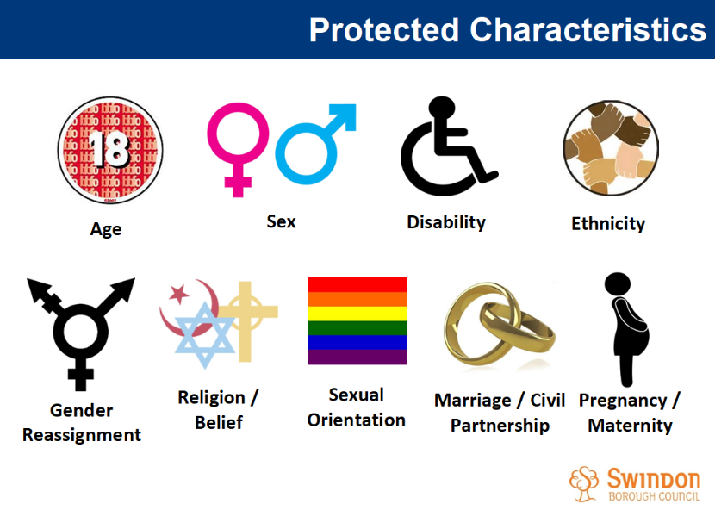
Equality Act 2010: 9

Slide 12

Strengthening: Discrimination
Direct Discrimination
Indirect Discrimination
Associative Discrimination
Perceptive Discrimination
Harassment (Third Party)
Victimisation
Disability Discrimination

Slide 13
Strengthening:
Reasonable Adjustment
The term 'reasonable adjustments' is not easy to define. It does mean that support and equipment must be provided that will help the person manage their individual difference/disability/needs
A reasonable adjustment is any alteration or accommodation necessary to enable a disabled individual to have the opportunity to demonstrate his/her abilities

Slide 14
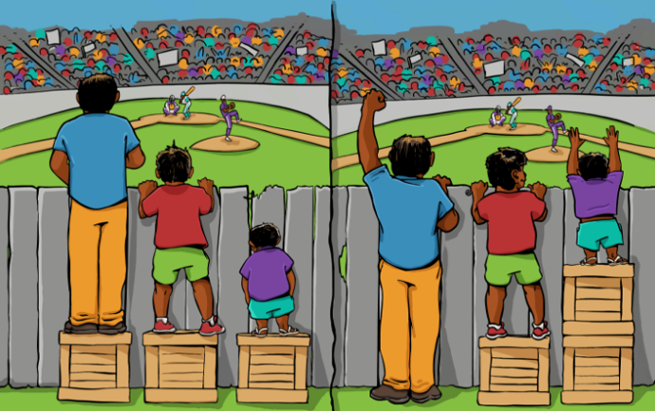
There are 3 types of adjustments:
Changing how things are done
Changing the environment
Provision of ‘auxiliary aids and services’

Slide 15
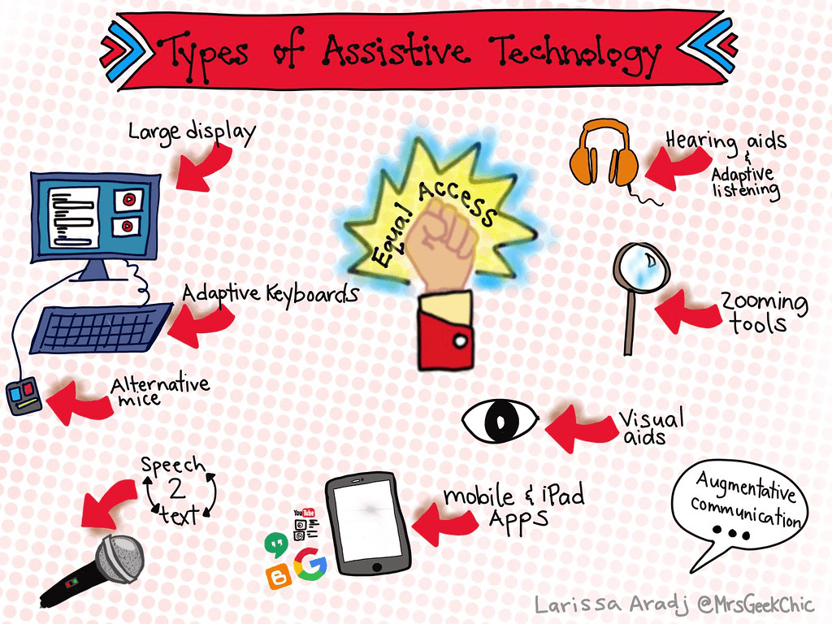

Slide 16

Common requests to support specific needs
Observable differences
Visual impairment
Later pregnancy
Physical disability
Broken Limbs
Wheelchair user
Invisible differences
Dyslexia/Dyscalculia
Role as a carer
ADD/ADHD
MS, arthritis
Cancer
Bad back
Early pregnancy
Mental health issues
Hearing impairment
ASD

Slide 17
Considerations when working with students with Specific Needs
How does the individual feel about their difference?
What adjustments (if any) are needed to support the specific need/disability? Who needs to know?
Confidentiality issues
Do you need to improve your knowledge on the issue?
Students with a specific needs still need to meet the expected standard

Slide 18
Practical considerations when Supporting Students with Specific Needs
Who assesses the student’s specific need?
If a reasonable adjustment is recognised, what is the time-frame/cost for these adjustments? Who pays?
Financial help for additional support - Disabled Student Allowance (https://www.gov.uk/disabled-students-allowances-dsas)
Who can/should you liaise with in supporting the student with their specific need/adjustments?

Slide 19
Mental Health
Being on placement can be stressful anyway, but with working from home / uncertainty of Covid 19, there may be more anxiety
Ensure supervision is regular, and time is set aside to discuss wellbeing at the beginning of every session
Soon after your student starts, explore with them how they manage, how you will know if they are struggling or anxious. Sharing your own experience/set the tone.
Be observant of how your student presents - if there are changes, try to explore these supportively. Find out from them what may help.

Slide 20

My Wellbeing reminder
What does Emotional Resilience means to me?
What behavioural, physical or emotional reactions to stress have I experienced? What has helped me manage these?
How can I reduce stress?
Who can I speak to?
What would help me to talk about my emotions?
What can I do to develop my resilience?

Slide 21

Supporting Students with Dyslexia

Slide 22
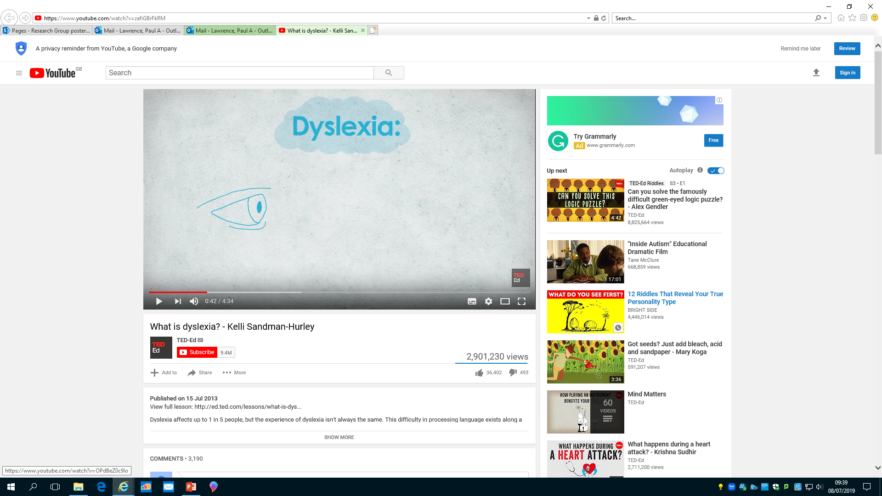
What is Dyslexia?
https://www.youtube.com/watch?v=zafiGBrFkRM

Slide 23
A personal experience
Verity and Sue’s personal experience of:
Coping Strategies
When coping strategies can be compromised
Assessment
Support in the workplace/ at university
Working with students who have dyslexia
Handout: Ways to support students with dyslexia

Slide 24
Key points about dyslexia
Dyslexic students have different problems/issues on different days – they do not all occur at once
There can be a form of grief that accompanies a dyslexia diagnosis, especially if this is quite recent
It is relatively common for dyslexia to be first diagnosed in higher education
Be mindful how much information the student is expected to ‘take in’ at any one time
Be mindful of how many tasks the student is expected to undertake at any one time
Evidence in our midway/final reports what support you have offered, and what the student has used, during the placement

Slide 25
Top Tips to promote your NQSWs learning
What is the students preferred learning style – ask them to complete Honey/Mumford (or similar) & discuss
Ask the student what is helpful to them
Be clear with your requests and take time to explain them
Follow up requests in an email
Encourage the ‘3 read rule’
Don’t ‘talk over’ the student
Slow down your conversations to/demands of the students when necessary

Slide 26


