Slide 1


Annual
Celebration & Social Work Awards 2022

Slide 2
Research shows that there are scientific benefits to cultivating and expressing gratitude…

Slide 3
So, today...

Slide 4
..is all about celebrating the social work profession…

Slide 5
..and your achievements, as Social Workers!

Slide 6
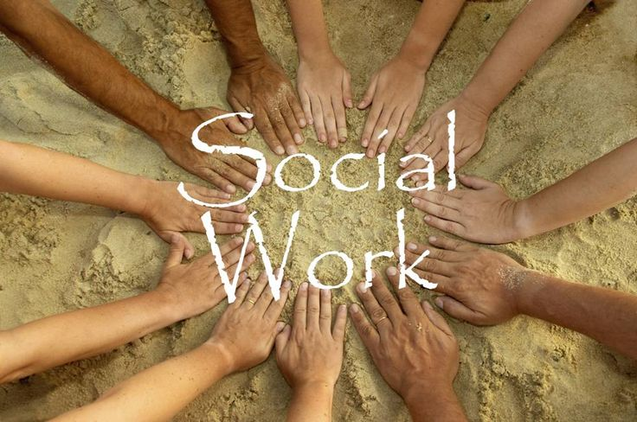

Slide 7
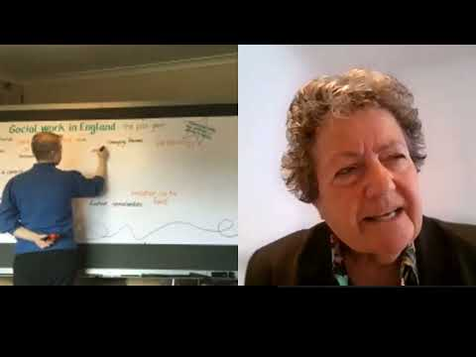
Social Work Week- Lyn Romeo, Chief Social Worker for Adults

Slide 8
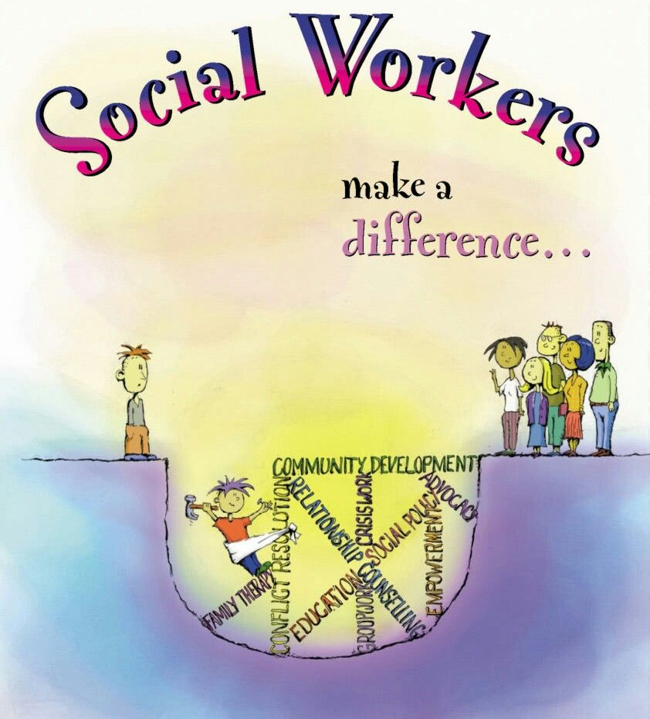

Slide 9
You Received Amazing Feedback from People with Lived Experience..
“Thank you for such a lovely review today, i really enjoyed it and do respect the way you do these. The kids loved it and it was great to hear C being so positive about herself”
-Anonymous

Slide 10
You Received Amazing Feedback from People with Lived Experience..
“She not only listened, she acted and made me feel that I wasn’t going through this alone as she was by my side every step of the way”
-Anonymous

Slide 11
You Received Amazing Feedback from People with Lived Experience..
“X is a lovely person and I liked playing the dice game and I like hearing about her dog”
-Anonymous, aged 7

Slide 12
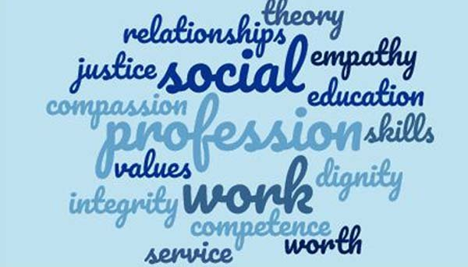

Slide 13
You Received Amazing Feedback From Colleagues..
“You’re the best manager I’ve ever had! You go above and beyond and supervision is a space where I feel that I can share my frustrations and worries at home and at work!”
-Anonymous

Slide 14
You Received Amazing Feedback From Colleagues..
“A NQSW is made by the team and I have had positive feedback, both formal and informal from colleagues who have watched her learn, grow and succeed. X is a real asset to the team and social work with adults, and I am very pleased she stepped out of her comfort zone and went for it.”
-Anonymous

Slide 15
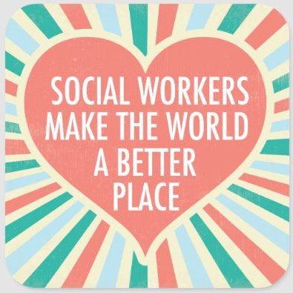

Slide 16

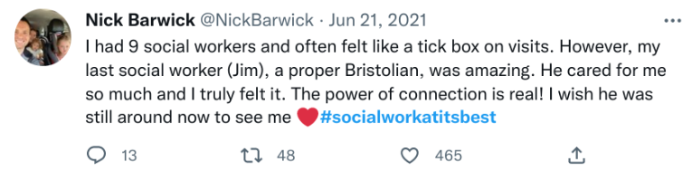
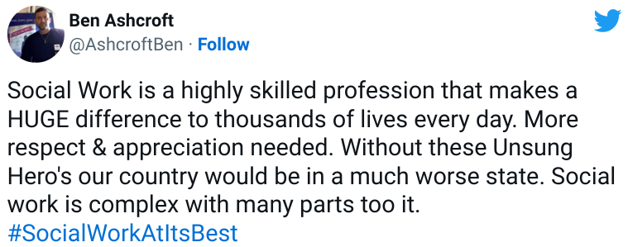
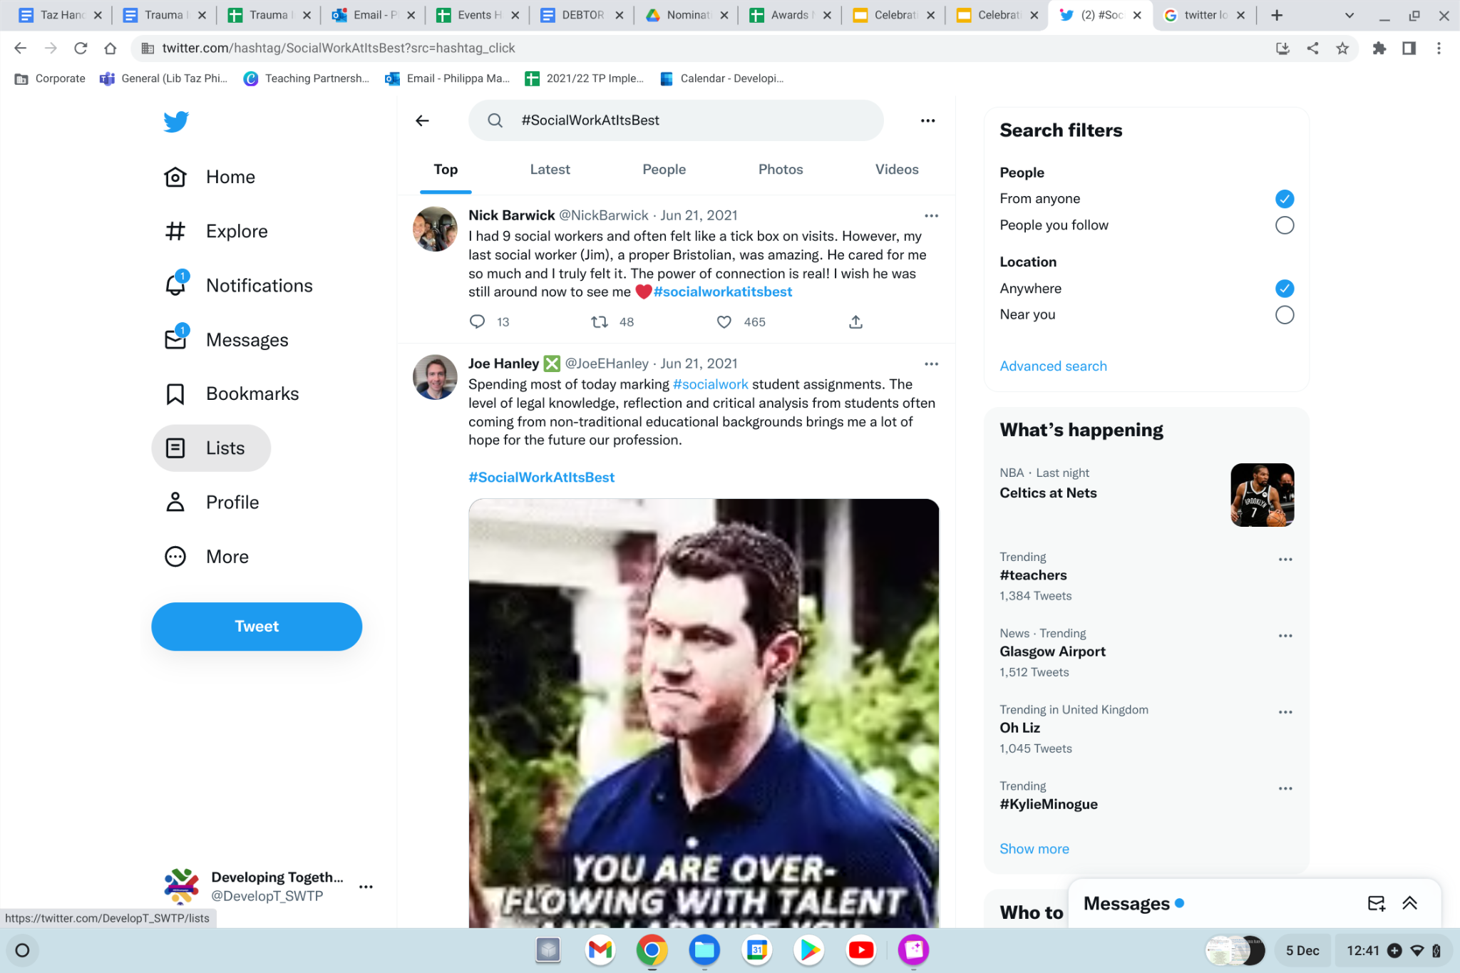
#SocialWorkAtItsBest

Slide 17
A letter to the social worker who changed my life
Dear Mel,
I wanted to write this letter to you to help you see the positive difference you have made in my life…
…you have been my saviour, the person that saved me from the destructive path I was on. You saw that I was broken and piece by piece you have helped me put myself back together.
There is no doubt that without your support, help and guidance I wouldn’t be the young person I am today. You very much inspire me to be the best version of me that I can be. My future, which was once bleak, is now bright and full of ambition.
-Beth
Community Care article

Slide 18
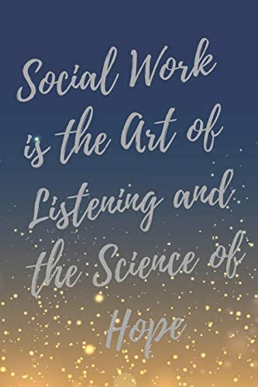

Slide 19
A love letter to social work
An extract from a 'Love Letter to Social Work', a beautifully written account of the social work profession by Liz Sales, who has since sadly passed away, published by Social Work England.
Social work has defined me – it has helped me to look for the best in people, to look at things from other people’s point of view and to believe it is always worth trying to help people have better lives.
Social work has also brought me many friends and amazing colleagues in the different places I have worked and many, many laughs (social workers often have a wicked sense of humour).
It has been a pleasure and a privilege to have my life enriched by so many children, young people and their families and maybe I can carry on for a little while, maybe I can’t, but I will still always be a social worker.
-Liz

Slide 20
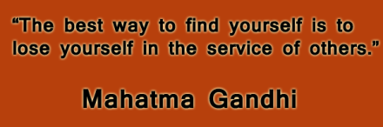

Slide 21
How a social worker saved my life
Talking with me and getting me to reframe my view of the world and my situation over several months…this social worker, she did it. It took those incredible reserves of resilience, perseverance, empathy, commitment, and skill that are the hallmark of all good social workers.
She did the normal social work stuff – arranging support, making suggestions – but more importantly, she saw me as a person. She was prepared to think flexibly, listen to me and what I wanted, and think of different ways to help me move out of that dark place.
Next time my social worker knocks on the door, my answer will be:
“Come in, I want to thank you for saving my life.”
-Clenton
Community Care article

Slide 22
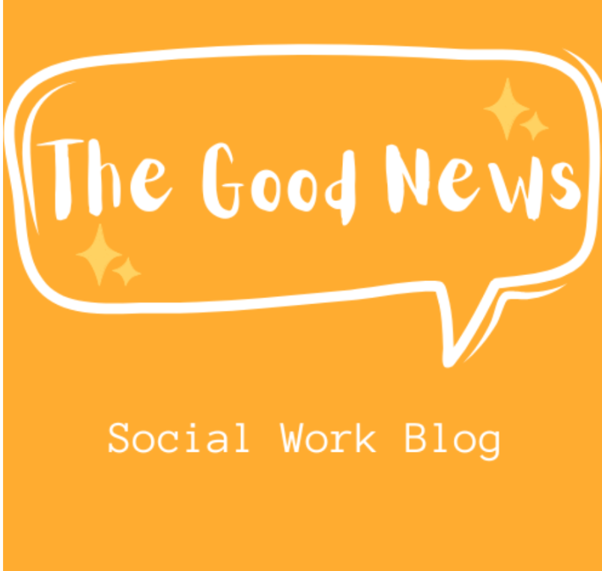
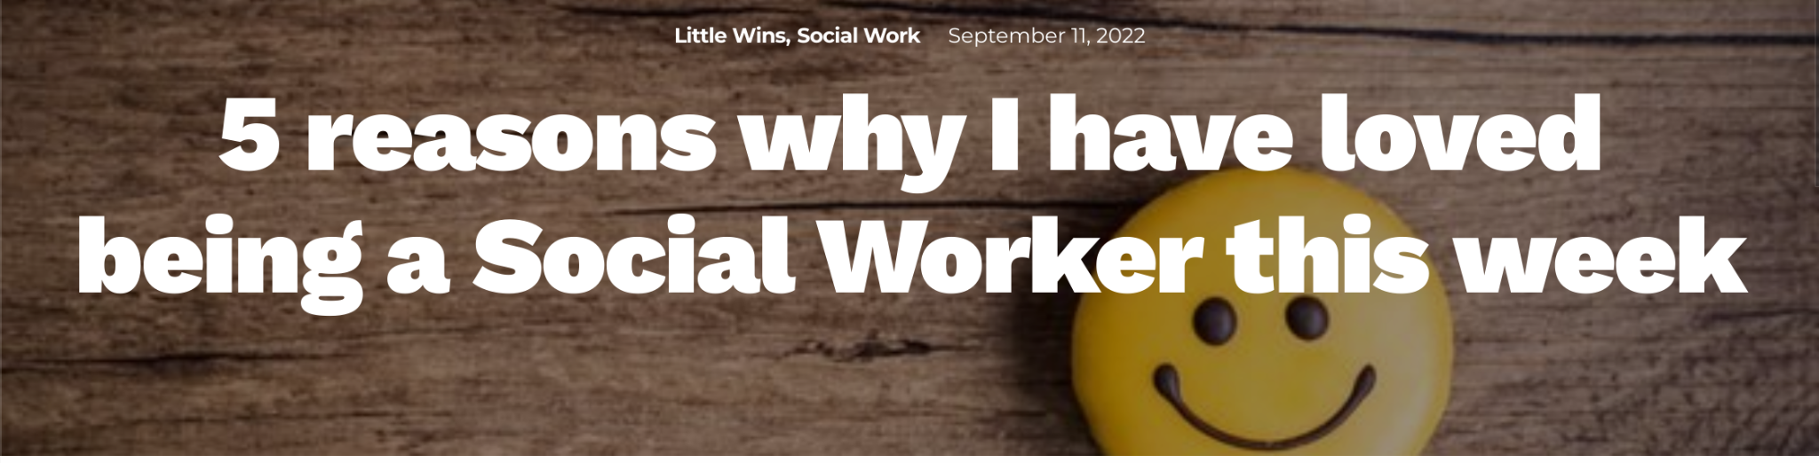
The Social Work Good News Blog: https://the-good-news.co.uk/
1. I said goodbye to a family I have been working with for nearly two years
2. I helped a father do what was right for his child
3. I only marginally lost a dance contest with one of the children I work with
4. A young person opened up to me
5. I met a new family and they told me they felt that I had actually listened to them

Slide 23
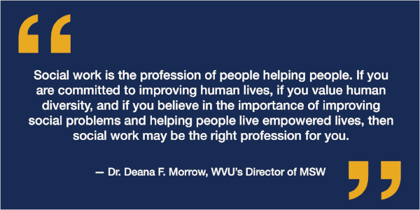

Slide 24
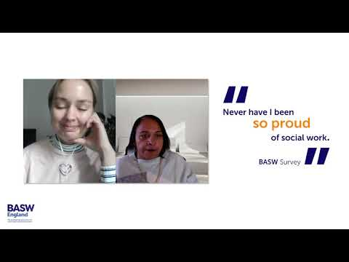

Slide 25
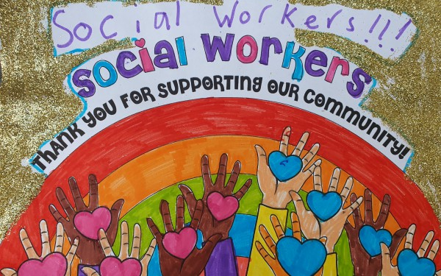

Slide 26
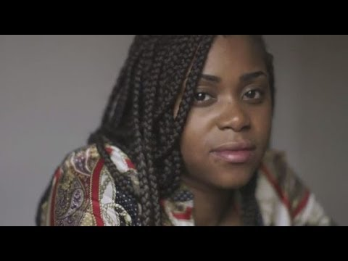

Slide 27
So, for everything you do….

Slide 28
