Slide 1



Social Work Awards
2022
Notes:
Sharon Evans

Slide 2
PRIZES
Winner
. £50 Love2Shop voucher
. Certificate of achievement
Special Mention
. £25 Love2Shop voucher
. Certificate of achievement
Shortlisted
. £10 Love2Shop voucher
. Certificate of achievement
Categories
Outstanding Contribution to Supporting Equality & Diversity
Outstanding Contribution to Social Work Teaching & Academia
Social Work Student of the Year
Social Worker of the Year (Children)
Social Worker of the Year (Adults)
NQSW of the Year (Children)
NQSW of the Year (Adults)
Team Leader of the Year (Children)
Team Leader of the Year (Adults)
Notes:
Sharon Evans

Slide 3

Outstanding Contribution to Supporting Equality & Diversity
Notes:
Florence Clark

Slide 4

Andrea Mcdermott
Andrea is an especially committed and authentic leader of anti-racist practice in Wandsworth. She has taken a leadership role in developing our workforce plan arising from the WRES and has been instrumental in the development and set up of our workforce talent initiative for Black and Brown staff called “Upstream Scheme” which was launched in September 2022.
Her passion, deep commitment and relentless energy for equalities, diversity and inclusion is totally inspiring. She is a truly exceptional individual who has brought so many people into the equalities conversation. Her willingness to share her own stories and to be vulnerable and help others has set the groundwork for safe spaces for everyone to speak, listen and grow together. Andrea is the epitome of the accomplished professional who has given her all to this agenda and then some.
Notes:
Florence Clark

Slide 5
Social Work Student of the Year
Notes:
Wilson

Slide 6
Isaac Snow
Isaac‘s academic work has been of an exceptionally high standard throughout the course, with him reading widely and demonstrating that he is able to go above and beyond what is expected of the module learning aims, often making me think more deeply about social work practice and the experiences of children and families who use social care services.
Overall, Isaac’s contribution to the Step Up to Social Work course has been outstanding and the feedback from his PE’s and the managers where he has been on placement indicates he is working at an extremely high level as a student social worker in practice. He is a credit to Kingston University and we wish him all the best for his future career in social work.
Notes:
Wilson

Slide 7

Siobhan Quinn
Siobhan undertook her final placement in a team working with young people who face tremendous risk and the team balance risk continuously. This work is not for the complacent and to have a student social worker who both embraced this work and specifically wanted to return to the team as an NQSW is exceptional.
She is a fantastic practitioner who is able to connect with her families and young people. She has been able to engage some of our hardest to reach young people and has been able to use creative direct work tools to evoke their lived experience, wishes and feelings. She is always able and willing to help the team out and is a real support for our team!
It’s a pleasure to have her in our team and she has a very exciting career ahead!
Notes:
Wilson

Slide 8
Outstanding Contribution to Social Work Teaching & Academia
Notes:
Wilson

Slide 9
The ‘SWAD’ Team at Kingston University:
Susan Watson, Dermot Brady and
Jacqueline Harry
This team has achieved tremendous outcomes in a short time. Their ability to translate course plans into deliverable action and develop student support systems demonstrates their academic abilities and dedication to improving student outcomes.
They are ‘super-committed’ to the learner experience and will mostly be found working long after and between hours, in order to address learners’ concerns or needs, prepare varied, stimulating, thought-provoking classes and provide detailed assessment feedback, developing mentor support material, in addition to meeting university and regulatory requirements.
Notes:
Wilson

Slide 10
Jane Mathew-Byrne
Jane works heartfully and diligently, building positive relationships with students, and colleagues both at the university and within the teaching partnership. She has built up a reputation for being an effective troubleshooter, and has developed a formidable knowledge base around practice education, practice
educators and effective learning. She has a detailed knowledge of individual students and their specific needs, the resources available and a number of intractable quality assurance issues.
Both students and staff have come to rely on her practice wisdom through the complexities, ups and downs of the academic year. She is a vital and indispensable member of the team!
Notes:
Wilson

Slide 11
NQSW of the Year
(Children)
Notes:
Anna Holland

Slide 12
Sinitta Russell
Sinitta has worked very hard with all allocated children and families over the course of her newly qualified year, and has faced some very challenging cases. She tackled these with confidence, seeking guidance when necessary.
She was recently praised by a Police Officer for her presentation in her first Initial Child Protection Conference which was lengthy and difficult, but she maintained composure and professionalism.
I think Sinitta should be considered as a role model within the social work profession as she is passionate about the work she does and this is evident through the way she works with families, as well as the way she records her work. Sinitta works hard, is not afraid to face new challenges and maintains a bubbly demeanor that contributes to team morale.
Notes:
Anna Holland

Slide 13
Wendy Smallwood
Wendy brings energy, containment, and practice knowledge…She is child focused and empowering, respectful and dedicated. Wendy has shared that she gets real satisfaction from her direct work with children and families and shares joyful moments with the families she supports.
I was inspired by Wendy and her diligence in finding ways to reach children. In supervision, Wendy’s face lit up as she described having a breakthrough in ‘reaching’ a child who is nonverbal.
Wendy is a role model for the social work profession. She has stretched the limits of understanding around direct work. Such resourcefulness!
Notes:
Anna Holland

Slide 14
NQSW of the Year
(Adults)
Notes:
Rachel Lukwago

Slide 15
Rowena Dennis
Rowena has made particular efforts to put people with lived experience (PLE) at the centre of her work, she has acted as a strong advocate. Rowena is living proof of transferable skills. She has done a variety of jobs including care work, and brings those skills to her role. Her training placement experiences were not in direct frontline work with adults and so she has had to catch up with this area of work. Rowena is a real asset to the team and social work with adults, and I am very pleased she stepped out of her comfort zone and went for it.
Hearing of Rowena’s caring nature, and ability to support people when they are distressed and reluctant to engage, shows a quality that we should all aim to achieve.
Notes:
Rachel Lukwago

Slide 16
Helen Siriboe
Helen is a role model for the social work profession. Helen inspires the social workers in the ASYE program. Helen’s focus on developing relationships and ensuring people's’ needs, aspirations and outcomes are fulfilled is evident in her work. Furthermore, I have received excellent feedback from carers and PLE in light of Helen’s positive contribution to their lives:
“I found Helen’s support invaluable; she not only listened, she acted and made me feel that I wasn’t going through this alone as she was by my side every step of the way”
Notes:
Rachel Lukwago

Slide 17
Team Leader of the Year (Children)
Notes:
Sharon Evans

Slide 18
Charles Carew
What makes Charles a great Team Manager is his commitment to us as individuals and as a team. Charles has also been a great role model to model my own practice off and he has supported me to develop my individual style, experience, and strengths as a practitioner.
Charles has always been there to offer support and guidance and looks at my needs. I feel privileged to be managed by him and it makes me love the practice more. His positive attitude makes him find the best way to tell me what to improve on.
There is so much more I could say about Charles as a team manager, but I will end with this; If an award could be created just for Charles, I would call it “above and beyond the call of duty”.
Notes:
Sharon Evans

Slide 19
Team Leader of the Year (Adults)
Notes:
Valentine

Slide 20
Adriana Lazdins
She took on the team at a very challenging time having come of
pandemic but she made working together more enjoyable and has
helped the team to stay motivated during ‘difficult times’. Feedback from
the team is that this has enabled open communication, a good work ethic,
flexibility and a better understanding of each person’s roles and
expectations.
We are lucky to have leaders like her, she is well respected within the
team. She has been a role model for those aspiring to become leaders
through her commitment to developing and mentoring others. She is
always willing to lend a helping hand whenever someone needs it.
Notes:
Valentine

Slide 21
Social Worker of the Year (Children)
Notes:
Louise Jones

Slide 22
Rachel Morris
Rachel is an advocate for her children and effects change through knowledgeable and timely challenge of the local authority to ensure children’s needs are met and best outcome supported. She goes above and beyond the key tasks of her role to make children looked after feel special by arranging and promoting child centered and child led reviews using enthusiasm and creativity. She will join in any activity and allow children to have a voice, steering away from old style formal meetings. This has included conquering her fear of heights to do Go Ape at the request of one of her young people.
”Rachel is a lovely person and I liked playing the dice game with her and I like to hear about her dog” (K aged 7)
“Rachel is good at what she does” (YP, aged 14)
Notes:
Louise Jones

Slide 23
Sima Hirani
I have been impressed at her creativity in looking for ways to promote the LADO to agencies and parents. She wants to ensure that children are not harmed by those who they come into contact with outside the home. It is this extension work, which goes beyond her day to day role, that demonstrates her commitment to children and families.
It is telling that when Sima is away, and LADO calls are answered, there is often disappointment when the caller is told they can’t speak to Sima!
Notes:
Louise Jones

Slide 24
Social Worker of the Year (Adults)
Notes:
Lisa Hewitt

Slide 25
Pauline Mccullough
Pauline goes the extra mile in all of her case work, she strives for perfection and is happy for her work to be appraised. Pauline’s professionalism is exemplary, and she models key social work behaviours. Pauline is a clear and very positive role model and has encouraged people who thought they could never become a social worker for a variety of reasons, and has shown how it is possible to overcome almost all barriers if you are as determined in the pursuit of this profession as she has been.
Notes:
Lisa Hewitt

Slide 26
Camilla Gibbs
When working with others, Camilla’s empathy, sensitivity, and approachable demeanor shines through. Due to Camilla’s interpersonal skills, she has had success in engaging with individuals that have been considered difficult to engage with by other professionals. Camilla is seen as a role model across Adult Social Care. Not only is she a go-to person for guidance and advice from others, but she is respected and admired due to her resilience and openness with others. Camilla is an asset to our department, a true STAR, and gives Social Work a good name!
Notes:
Lisa Hewitt

Slide 27
Mafereh Kamara
She shows a strong sense of working in a solution focused manner, and supports other professionals and works collaboratively to achieve best outcomes for individuals. It is also nice to see the energy that her colleagues feels that she brings to the workforce, especially when things can be more difficult due to work pressures, changes following covid and as a result a workforce that needs to support one another and individuals’ wellbeing.
Notes:
Lisa Hewitt

Slide 28
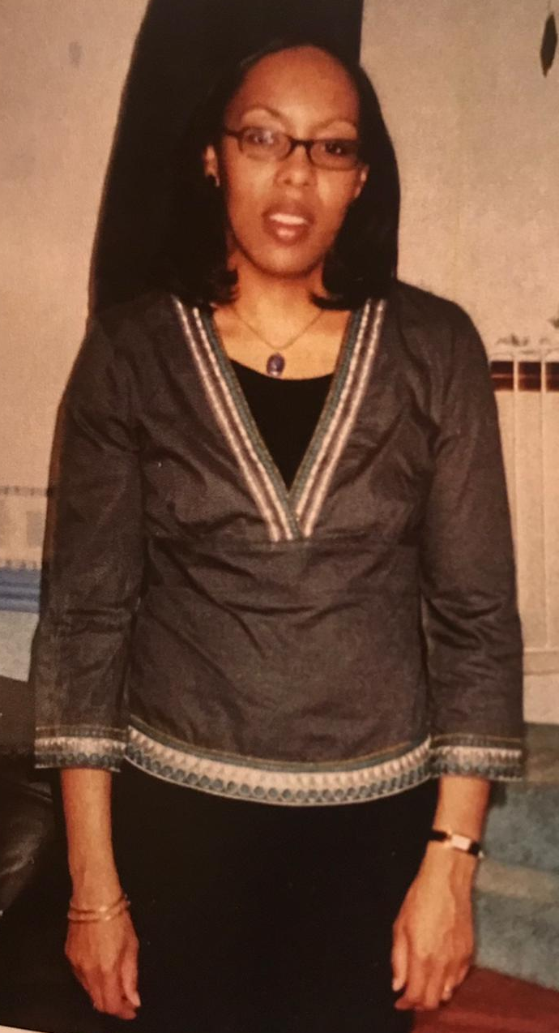
Bernita Fuwa
This award is being posthumously awarded to Bernita’s team, in her memory. Bernita sadly passed away in September 2022, at the age of just 54.
“It was very apparent on hearing this very sad news of the impact Bernita had on the teams she had worked in and the local authority as a whole. Bernita was truly a team player, dedicated to the vulnerable people she supported and who became a confident and very competent social worker. Bernita worked hard to improve the lives of the people she worked with and I believe that she did accomplish this. Bernita was beautiful inside and out and her core values of compassion, empathy, understanding, justice and equality emulated in all aspects of her work both with professionals and the people she served. Her patience and her calm and measured approach is both inspirational and serves to show the role model that she was for our profession.
We wish Bernita was with us to hear these words but we also know that she would be embarrassed as she was such a humble lady. We would like her impact on social work and within Croydon recognized as she truly did make a huge impact on the lives she touched with her amazing qualities”.
Pic here
Notes:
Tim Gray

Slide 29
Tawakalitu Ahmed
Masallah Bangura
Edith Ezekwe
Patrick Oderoha
Wunmi Adeyeri
Joanna Gorska
Notes:
Sharon Evans

Slide 30
Congratulations to everyone who was nominated for an award.
Thank you to those who put forward nominations and our fabulous shortlisting teams.
And Thank You to all of you for all your hard work this year!
Notes:
Sharon Evans

Slide 31
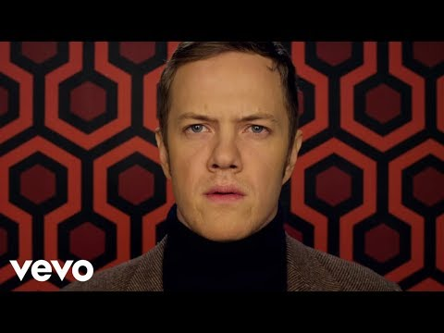
Thank you all for coming to join in with these celebrations. We hope you have enjoyed the morning and go back to work feeling on
‘top of the world’!
Notes:
Sharon Evans

